Slide 1

Distributed Computing and Parallel Processing-Based Live Video Surveillance:
Abdul Jalil Jadoon FA13-BCS-001
Fahama Babar Khan FA13-BCS-029
Muhammad Rohan Ali FA13-BCS-051
Supervised by: Dr. Osman Khalid
Co-Supervised by: Dr. Muhammad Usman Shahid
Department of Computer Science
COMSATS Institute of IT, Abbottabad

Slide 2
Agenda of the Presentation
Introduction
Scope
Functionalities
Proposed Tools/Platform
Feasibility
Technical
Financial
Resource
Operational
Schedule
Tasks for 1st Iteration (or 30%)
Conclusion

Slide 3
Introduction
Video Surveillance can be defined as the observation and analysis of specific area for safety purpose.
A distributed system is a model in which components located on networked computers communicate and coordinate their actions by passing messages.
parallel processing is the processing of program instructions by dividing them among multiple processors with the objective of running a program in less time
So this project is to automate live video surveillance by providing better safety and security via technology through parallel processing and distributed computing

Slide 4
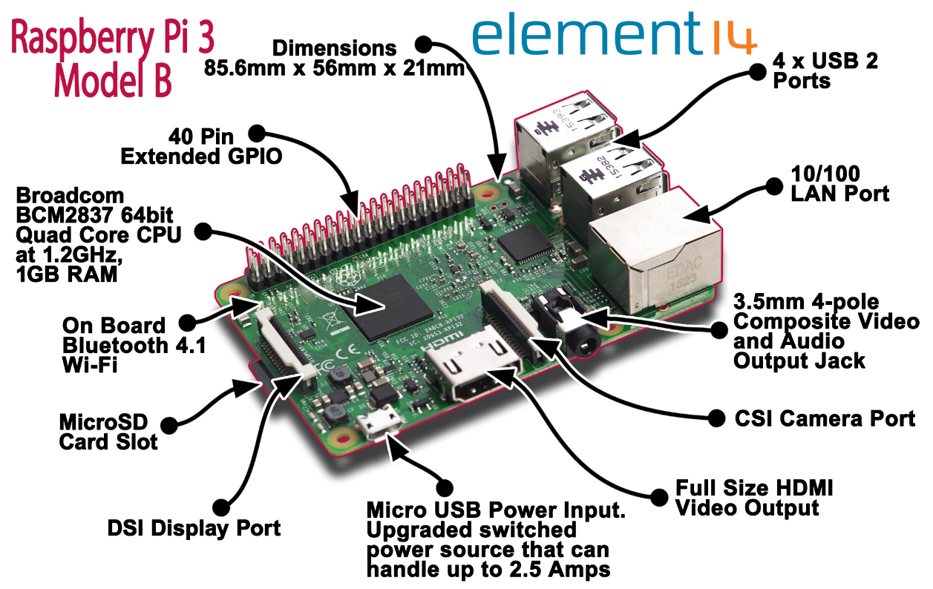
Introduction

Slide 5
Motivation
Major research is going on throughout the world to replace human operators with such advance systems.
It performs video real-time analysis for immediate detection of anomalous events or events of interest.
Cost –effective
Most effective when deployed with other security measures(e.g access control,alarm systems).

Slide 6
Scope
The scope of this project is restricted to following anomalies.
Tasks distributed in distributed network of Raspberry Pi’s
Tasks will be executed through parallel processing for better response time
Camera detect the face of the person
Not detect the person if his/her face is covered
Keeping his/her record in the database
Recognizing human if he crosses specific visits threshold
Warnings shall be generated if the person crosses specific threshold

Slide 7
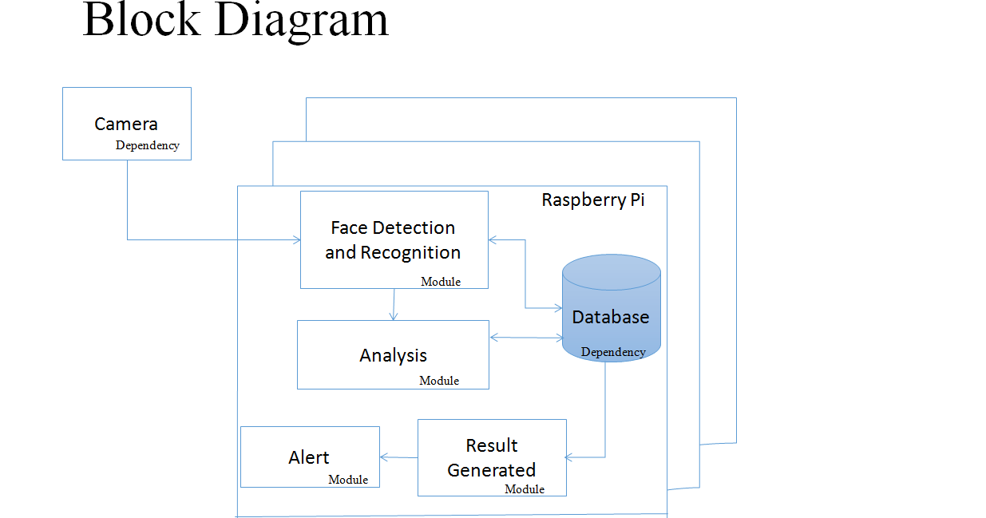

Slide 8
Functionalities
Distributed Computing Cluster
Parallel Processing
Face Detection
Face Recognition
Adding record in database
Detection of Frequent visit Anomaly
Generate warning for frequently visit Anomaly

Slide 9
Proposed Tools/Platform
Raspberry Pi’s
Camera
OpenCv
Raspbian
MySql

Slide 10
Technical Feasibility
In OpenCv we will use class CascadeClassifier for face detection
In OpenCv we will use class FaceRecognizer for face recognization
MySql will be used to store data.
Raspberry Pi 3 is already purchased.
Raspberry Pi 3 supports various operating systems for example: windows 10 IoT, raspbian, ubuntu mate, etc.
OS is Raspbian because it is officially supported & based on Debian OS.

Slide 11
Financial Feasibility
Resource Name | Price | Source
Raspberry Pi3 (x3) with SD Card | 16,000 | instock.pk
Camera | 1,500 | Locally Market
Keyboard, Mouse, LCD | Already available | Self
Switch | Rs 850 | Local Market
Ethernet Cables | Already Available | Self
Raspberry Pi Official Charger(x3) | 4,500 | Instock.pk
Sponsors/ Funding sources | Self

Slide 12
Resource Feasibility
Raspberry pi 3 will be bought form instock.pk. Other hardware accessories are already purchased.
Software and libraries are openly available free of cost.
OpenCV: http://opencv.org/
Raspbian: www.raspberrypi.org/downloads/

Slide 13
Operational Feasibility
Our project is a real world implementation
Used by governmental organizations and as well as privately held companies to enhance their security.
Cost effective due to parallel processing
Deploy in small organization

Slide 14
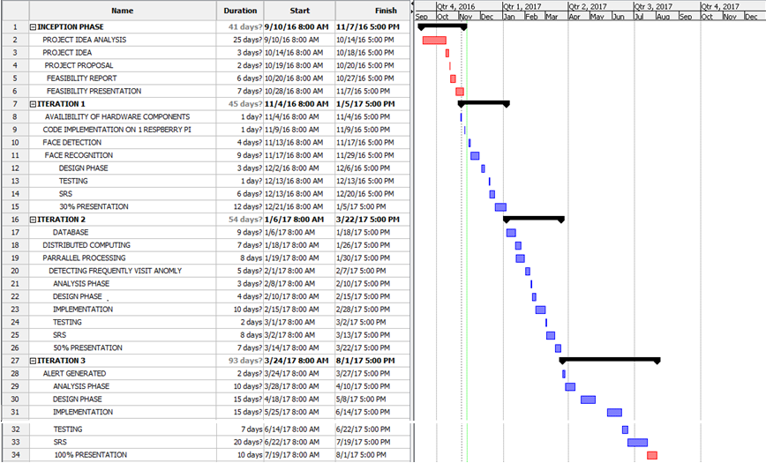
Schedule

Slide 15
Tasks for 1st Iteration (or 30%)
1st Iteration
Arrangement of hardware components
Code implementation on one raspberry pi
Face detection
Face recognition
Detection of Frequent visit Anomaly
Analysis
Design
Implementation
Testing
Srs

Slide 16
Conclusion
Helps in security management
Provide Secured enviornment
Cost effective.
The system will be feasible in context of technicality, finance, resources, and operation

